Slide 1

OPEN LAB PROJECT
PREDICTION OF FAKE NEWS
Team:
Aruneswari S - CB.EN.U4ECE18107
Ramakrishna - CB.EN.U4ECE18110
Chandhana S - CB.EN.U4ECE18112
Nirali M Dave - CB.EN.U4ECE18136
R.R.Prathiksha - CB.EN.U4ECE18144

Slide 2


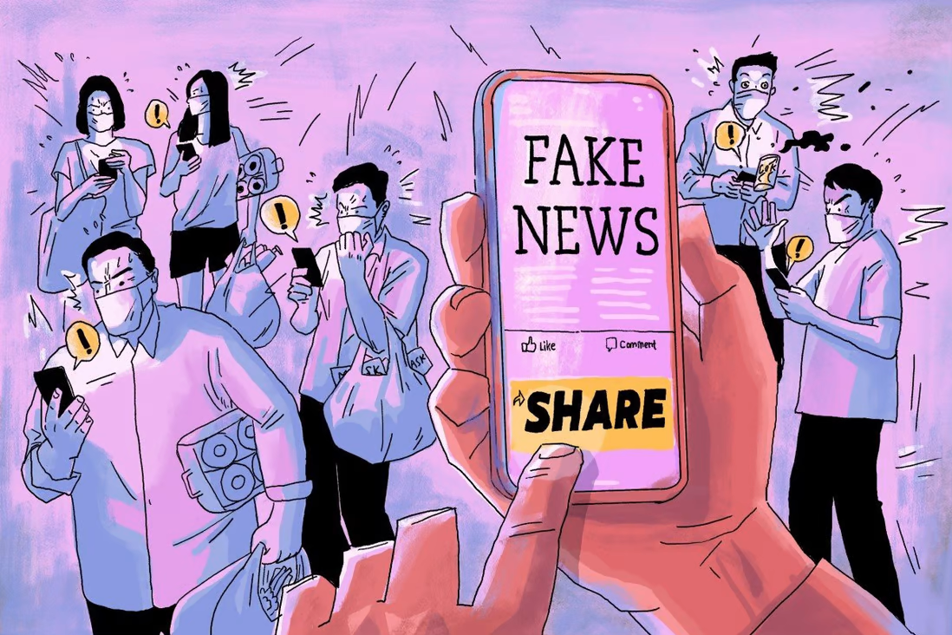

PROBLEM STATEMENT

Slide 3

PROPOSED SOLUTION
GOAL
Develop a model that classifies a given news as fake or real news using Machine Learning

Slide 4
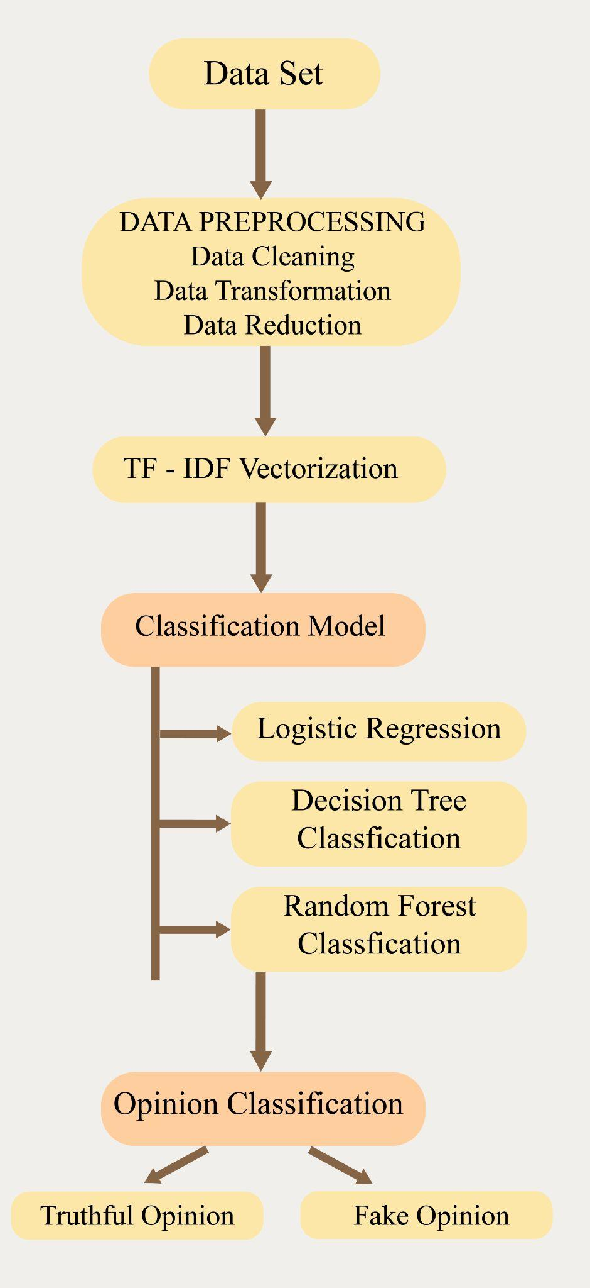
FLOWCHART
Dataset : US news article from Kaggle
Data Preprocessing : Removal of meaningless characters and
Reduction of duplicate characters. Cleaning of data.
Vectorization : Conversion of data into numeric format
Classifier Model : Train the model using the train dataset. Given a news it predicts true or false using 3 ML models.
Output : Real or Fake news
Comparison of Accuracy of the three models

Slide 5
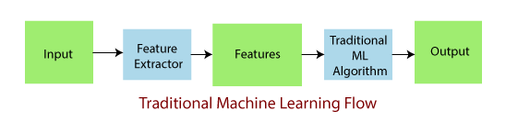
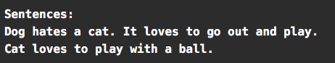
WHY VECTORIZATION?
Can’t be in the form of image/text
Vectorization
Text → Numerical
Documents?
Corpus?
Feature?

Slide 6
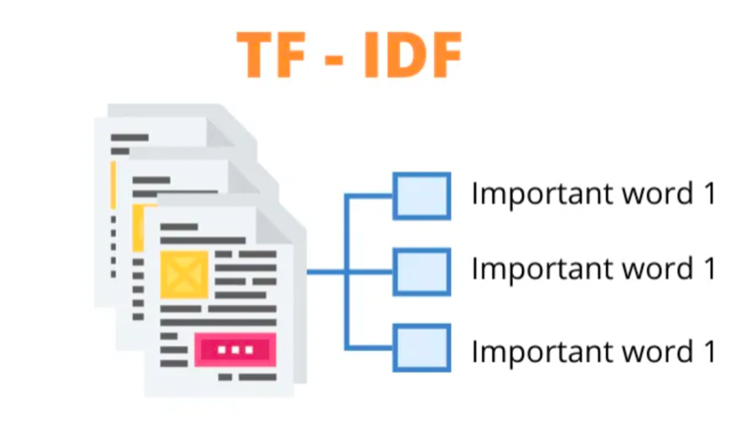
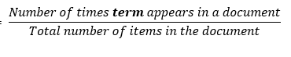
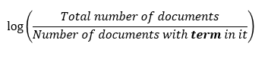
TF-ID TERM FREQUENCY INVERSE DOCUMENT FREQUENCY
Documents → After cleaning data
1. Good boy 2. Good Girl 3. Boy Girl Good
 | Doc 1 | Doc 2 | Doc 3
Good | ½ | ½ | ⅓
Boy | ½ | 0 | ⅓
Girl | 0 | ½ | ⅓
Term Frequency
Word | Freq
Good | 3
Boy | 2
Girl | 2
Words | IDF
Good | log(3/3) =0
Boy | log(3/2)
Girl | log(3/2)
IDF

Slide 7
FEATURE TABLE
FINAL : TF * IDF
Features | F1 | F2 | F3
WORDS | GOOD | BOY | GIRL
DOC 1 | 0 | ½ * log(3/2) | 0
DOC 2 | 0 | 0 | ½ * log(3/2)
DOC 3 | 0 | ⅓ * log(3/2) | ⅓ * log(3/2)
Contains a weight value that signifies how important a word is for an individual text message or document
TF-IDF gives more weight to less frequently occurring events and less weight to expected events
The product of TF x IDF of a word indicates how often the token is found in the document

Slide 8
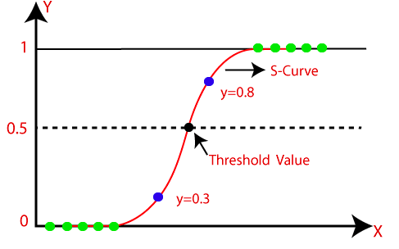
LOGISTIC REGRESSION
REGRESSION ALGORITHM
→ Predicts if something is “TRUE” or “FALSE”
OUTPUT OF ALGORITHM
→ Probabilistic Value between 0 and 1
THRESHOLD VALUE
→ Output > Threshold Value → Output “1”
→ Output < Threshold Value → Output “0”
Logistic Regression Curve
X-axis : represents the feature : Features after vectorization : weights of occurrence of each doc
Y- axis : Probabilistic Value
Output Of Algorithm : Based on the feature value, predicts TRUE or FALSE

Slide 9
DECISION TREE CLASSIFICATION
Salary is between Rs. 30000 and Rs. 60000
Supervised Learning technique
A tree-structured classifier
Decision nodes
Leaf nodes
Decisions or the test are performed on the basis of features of the given dataset
Branches into subtrees - based on the answer (Yes/No)
How to construct decision trees?
No
Yes
Decline
Office - near to home
No
Yes
Decline
Provides cab facility
No
Yes
Decline
Accept

Slide 10
DECISION TREE CLASSIFICATION
ROOT NODE
Decision Node
Decision Node
Decision Node
Leaf node
Leaf node
Leaf node
Decision Node
Leaf node
Leaf node

Slide 11
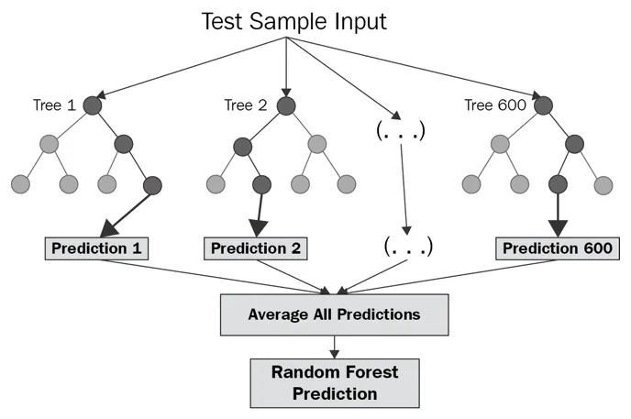
RANDOM FOREST CLASSIFICATION
Supervised Learning
Ensemble Learning
Many decision trees are created using random datasets.
Prevents Overfitting

Slide 12
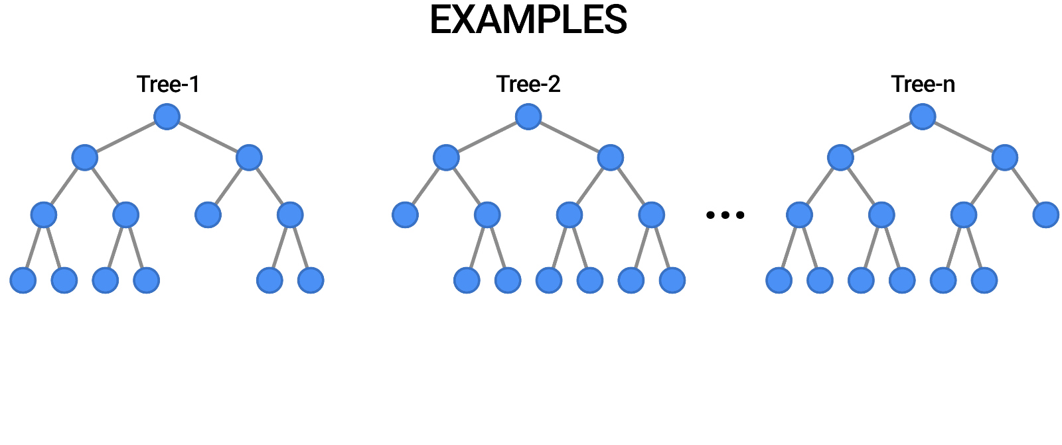
EXAMPLE - RANDOM FOREST CLASSIFICATION

Slide 13
DELIVERABLES
Predicting if the news is true or false
Applying different ML models
Logistic Regression
Decision Tree Classification
Random Forest Classification
Compare and analyse accuracy of the three ML models

Slide 14


